Slide 1
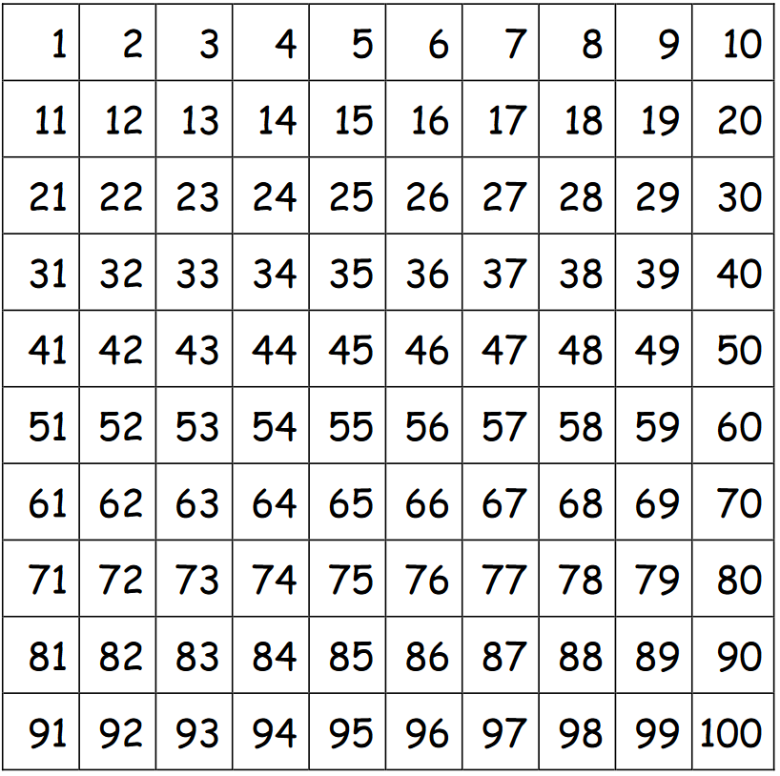
Captain Tom’s challenge
Decide on a activity that you could do most days of the week.
Do not make it too easy – it must challenge you!
Here are some examples: -
Walking 2 laps of the field
Running 4 laps of the playground
5 minutes skipping
Each time you complete your daily challenge, you need to colour in a square.
Once you have coloured in all of the squares, show your teacher and you will receive a certificate in recognition of your hard work.

Slide 2

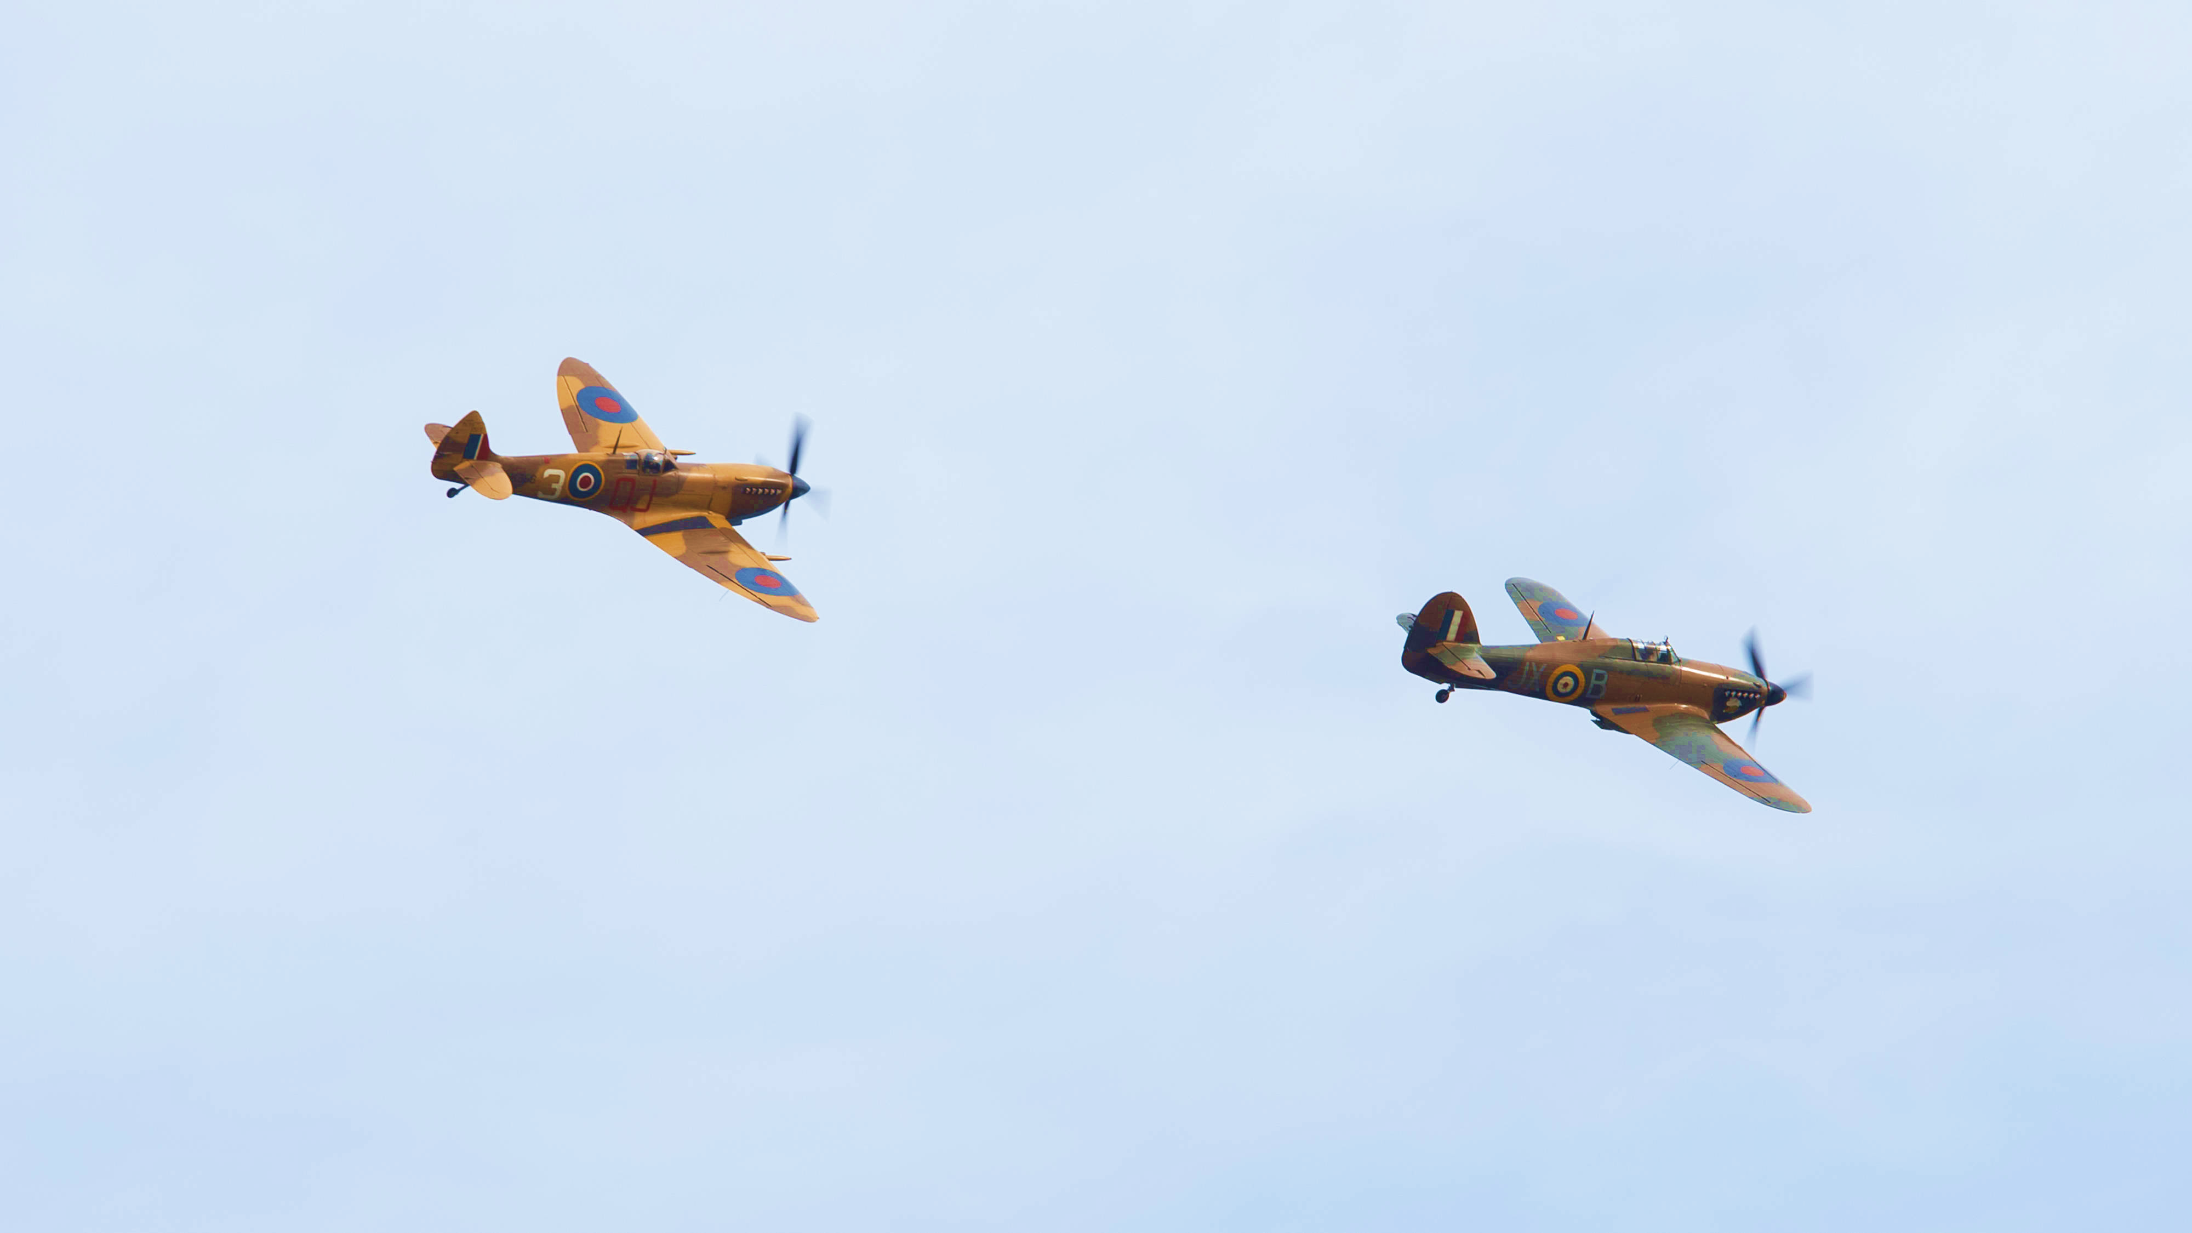
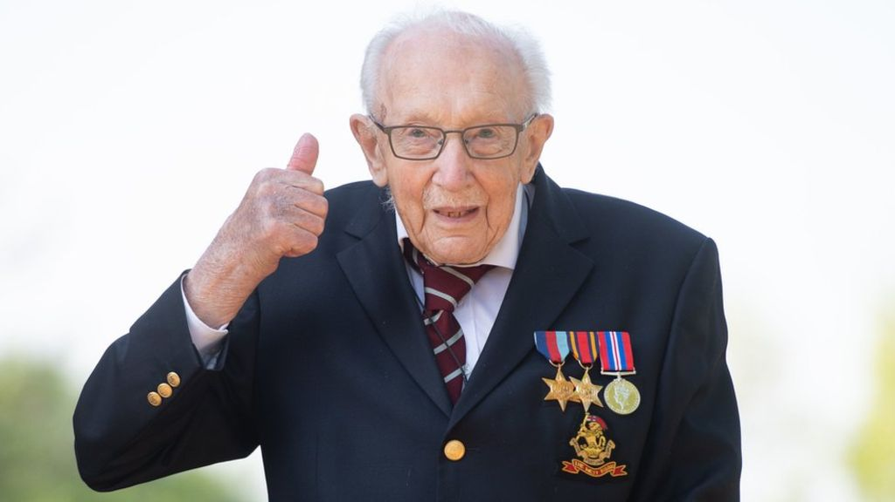
This certificate is awarded to
………………………………………………….
for completing this daily challenge
……………………………………………………………..
SIGNED………………………………………………..
DATE…………………………………………………….

Slide 3


This certificate is awarded to
………………………………………………….
for completing this daily challenge
……………………………………………………………..

